Slide 1
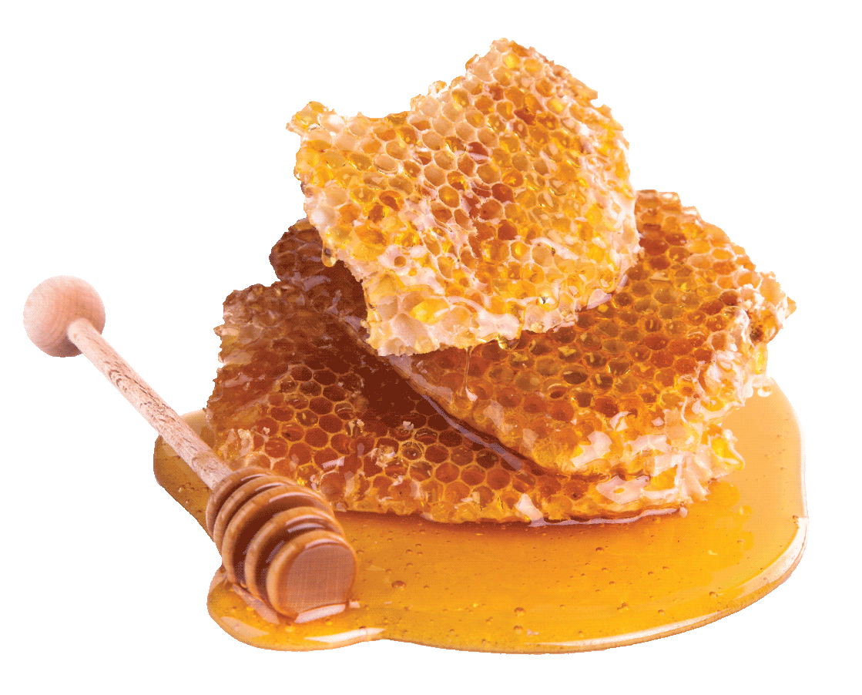
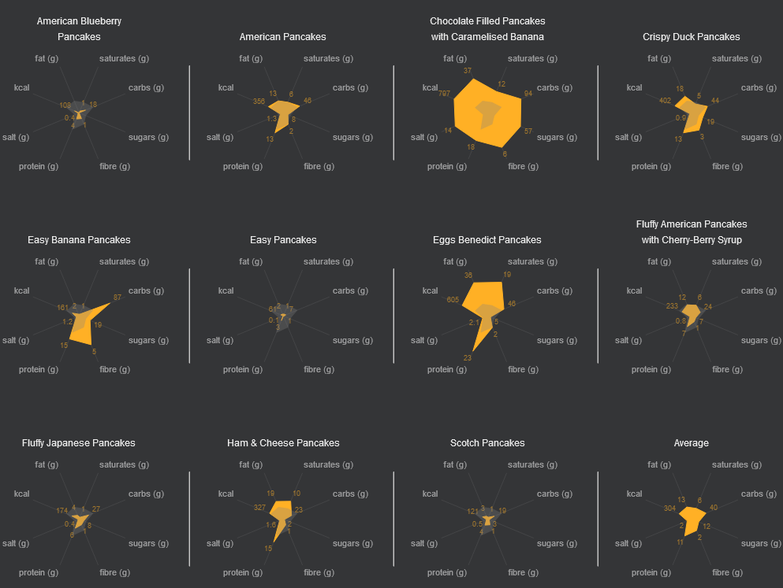
NOT ALL PANCAKES
ARE CREATED EQUAL
This year, Pankcake Day falls on the 21st February 2023
Shrove Tuesday was traditionally the last opportunity to use up eggs and fats before embarking on the Lenten fast and pancakes were the perfect solution!
Here are the 11 most popular pancake recipes according to BBB Good Food
Dataviz: Dav Bacci
Source: https://www.bbcgoodfood.com/howto/guide/most-popular-pancake-recipes

